Slide 1
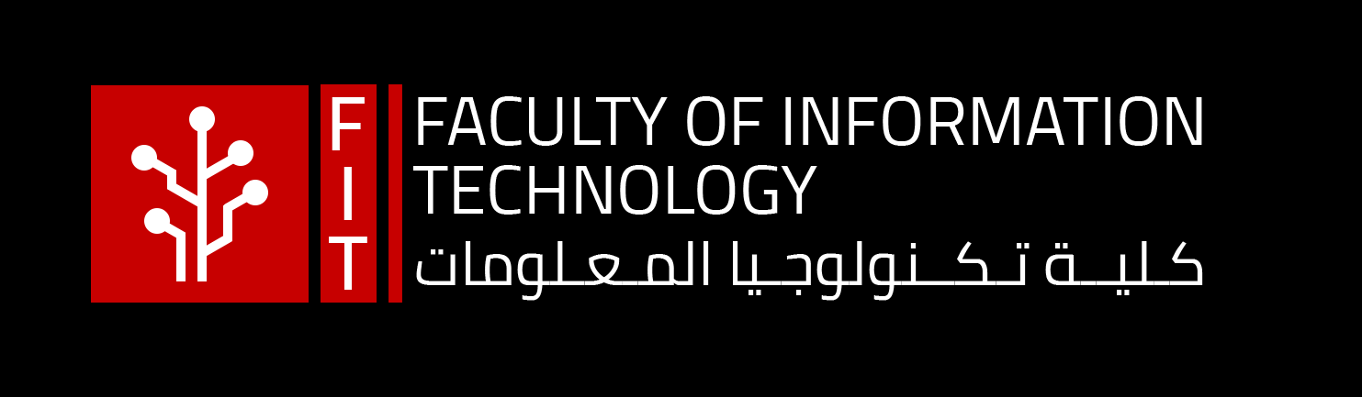
Chapter -3 Extreme Programming Development Part 2
By: Dr. Yousra Odeh
Edited by: Dr. Ahmed Otoom

Slide 2
Agenda
Extreme Programming (XP) Team Embrace Change.
XP Good Practices
Pair Programming
Test-Driven Development
Continues Integration
10- minutes build

Slide 3


Big Change in Circuit App
Before: As a trainer, I want to manage classes so customers can attend.
Now: As a customer, I want to suggest best timing classes, so I can attend what fits with my time.
Trainers
Circuit App
Complete redesigning work in the backend.
Reworking code means bugs.
Reworking code in the database.
Agile mind-set
accepts change
Customers

Slide 4
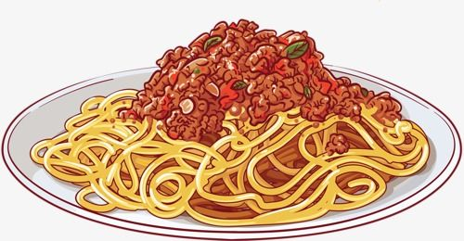
Spaghetti Code
A program's source code that is difficult to read or follow by a human because of how the original programmer wrote the code.
Spaghetti code is considered bad practice because if errors are experienced, it is more difficult to locate what is causing the error.
Spaghetti code can be reduced by keeping your code organized, formatted properly
Make your code clean and structured.

Slide 5
XP practices and Spaghetti Code
People on software teams resist changes when they’ve had bad experiences with rework causing bugs, but rework doesn’t have to do that.
XP helps teams embrace change with practices and values that help them to build software that’s easier to modify.
Values?
XP Good Practices ? → Next Slide
Notes:
People on software teams resist changes when they’ve had bad experiences with rework causing bugs... but rework doesn’t have to do that.
XP helps teams embrace change with practices and values that help them to build software that’s easier to modify.

Slide 6
Four XP Good Practices for a Good Feedback
Pair Programming
Test-Driven Development
Continues Integration
10- minutes build

Slide 7
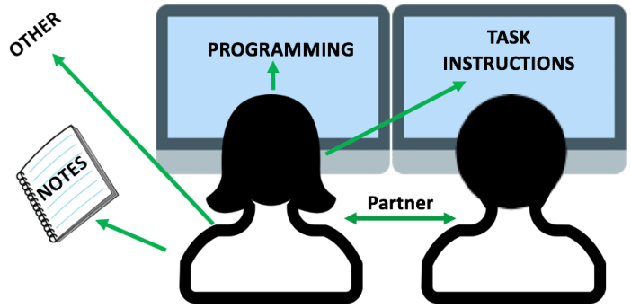
1. Pair Programming
Pair programming, is where two people sit at a single computer and write code together.
It is an effective tool for building high-quality code very quickly, because many people who do pair programming report that pairs get more work done together than they do when they work separately.
Pair Programming Advantages:
Everyone is focused.
Helps team catching bugs.
Easy to brainstorm.
Everyone in the team is involved.
High quality code and quickly.
Notes:
This is a new experience for people who are used to thinking of programming as a solitary activity.

Slide 8
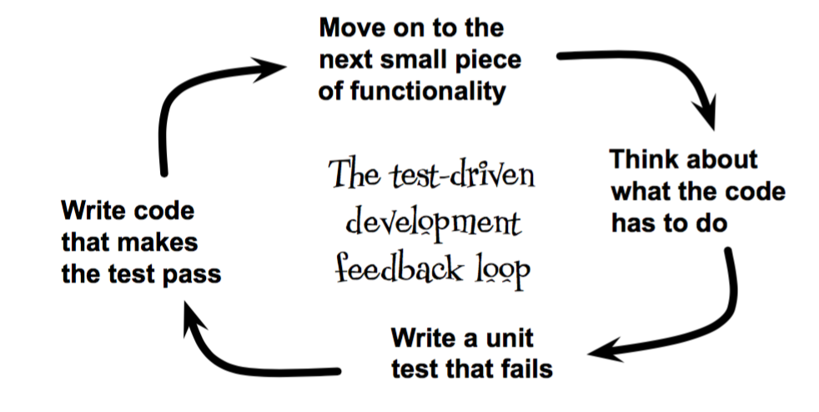
2. Test-Driven Development (TDD)
TDD is a practice, where programmers write unit tests before they write the code that it tests.
TDD forces you to really think through your code’s behavior before you dive into writing it through writing unit tests first.
Unit testing change the way the team designs the code.

Slide 9
a. Code is always divided into Units
A unit is the smallest testable part of any software. It usually has one or a few inputs and usually a single output.
In procedural programming, a unit may be an individual program, function, procedure, etc.
In object-oriented programming, the smallest unit is a method, which may belong to a base/ super class, abstract class or derived/ child class.
UNIT TESTING is a level of software testing where individual units/ components of a software are tested.
The purpose is to validate that each unit of the software performs as designed.
Notes:
Examples of computer procedural languages are BASIC, C, FORTRAN, Java, and Pascal.
Examples of OO C#.net, Java and Python.

Slide 10
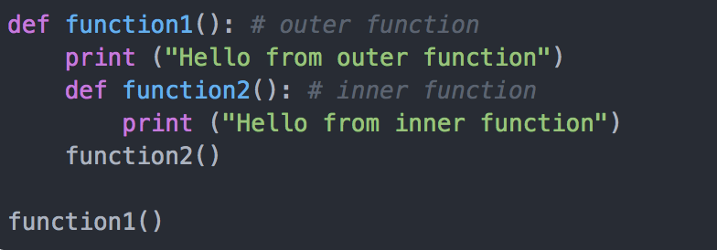
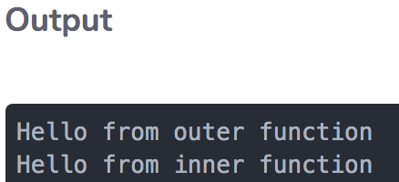
Python Example..
How to conduct unit testing ?
Notes:
Java files.. .java files are units of testing.
Public method.. To test function 1.

Slide 11
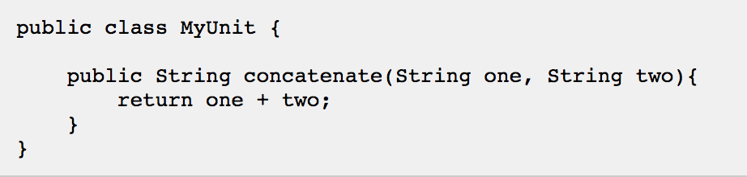
b. Each Unit gets its Own Unit Tests
These tests are written in same programming language.
Tests access visible parts such as Public methods in Java.
Writing the unit tests first forces the developer to think about how the code is going to be used

Slide 12
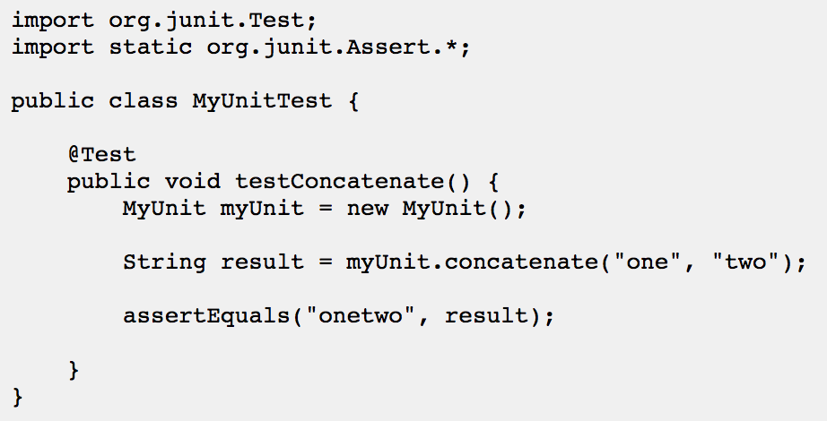
Java Unit Testing
Notes:
http://tutorials.jenkov.com/java-unit-testing/simple-test.html
Extra:
https://www.geeksforgeeks.org/unit-testing-python-unittest/
What is the kind of the testing? White Box Testing method is used for Unit testing.
Why white box testing?
assertEqual() – This statement is used to check if the result obtained is equal to the expected result.
assertTrue() / assertFalse() – This statement is used to verify if a given statement is true or false.
test_isupper This test is used to test the property of string which returns TRUE if the string is in uppercase else returns False. The assertTrue() / assertFalse() statement is used for this verification.

Slide 13
Unit Testing Benefits
Unit tests help to fix bugs early and save costs.
It helps the developers to understand the code base and enables them to make changes quickly
Unit tests help with code re-use. Migrate both your code and your tests to your new project.

Slide 14
Early feedback from design and testing
How?
Wireframes: to sketch out user interfaces before building them.
User Interfaces (UI) generate the most opinions from users and stakeholders, at early stages.
That’s why teams use wireframes to sketch out user interfaces.
There are a lot of different ways to create wireframes.
Some are basic sketches of the system’s navigation, while others are highly detailed representations of individual screens or pages.
It’s a lot easier to modify a wireframe than it is to modify code, so teams often review several iterations of each wireframe with the users.
Spike solutions: A spike solution is code written by a team member specifically meant to figure out a specific technical problem.
The only purpose of the spike solution is to learn more about the problem, and the code is usually thrown out after it’s done.
Usability Testing:
Usability: How easy to learn and how easy to use software.
Its common to discuss usability of a program interface.
Sitting users down in front of an early version of the UI that the team has been building and having them use it to perform tasks they need.
When XP teams do usability testing?
Notes:
→ it’s often done near the end of the weekly cycle so that the information they learned from it can be used in the next one,

Slide 15
3. Continues Integration
Everyone on the team constantly integrates the code in their working folders back into the repository,
so that nobody’s working folder is more than a few hours out of date.
When each person has the latest code in a working folder, conflicts show up immediately, and they’re a lot easier to x when they’re caught early.

Slide 16
4. 10 –Minutes Build
The team maintains an automated build that compiles the code, runs the automated tests, and creates the deployable packages. They make sure that it runs in 10 minutes or less.
A 10-minute build really helps with both continuous integration and TDD because it executes the unit tests, so you find out quickly if you add code that breaks an existing test.

Slide 17
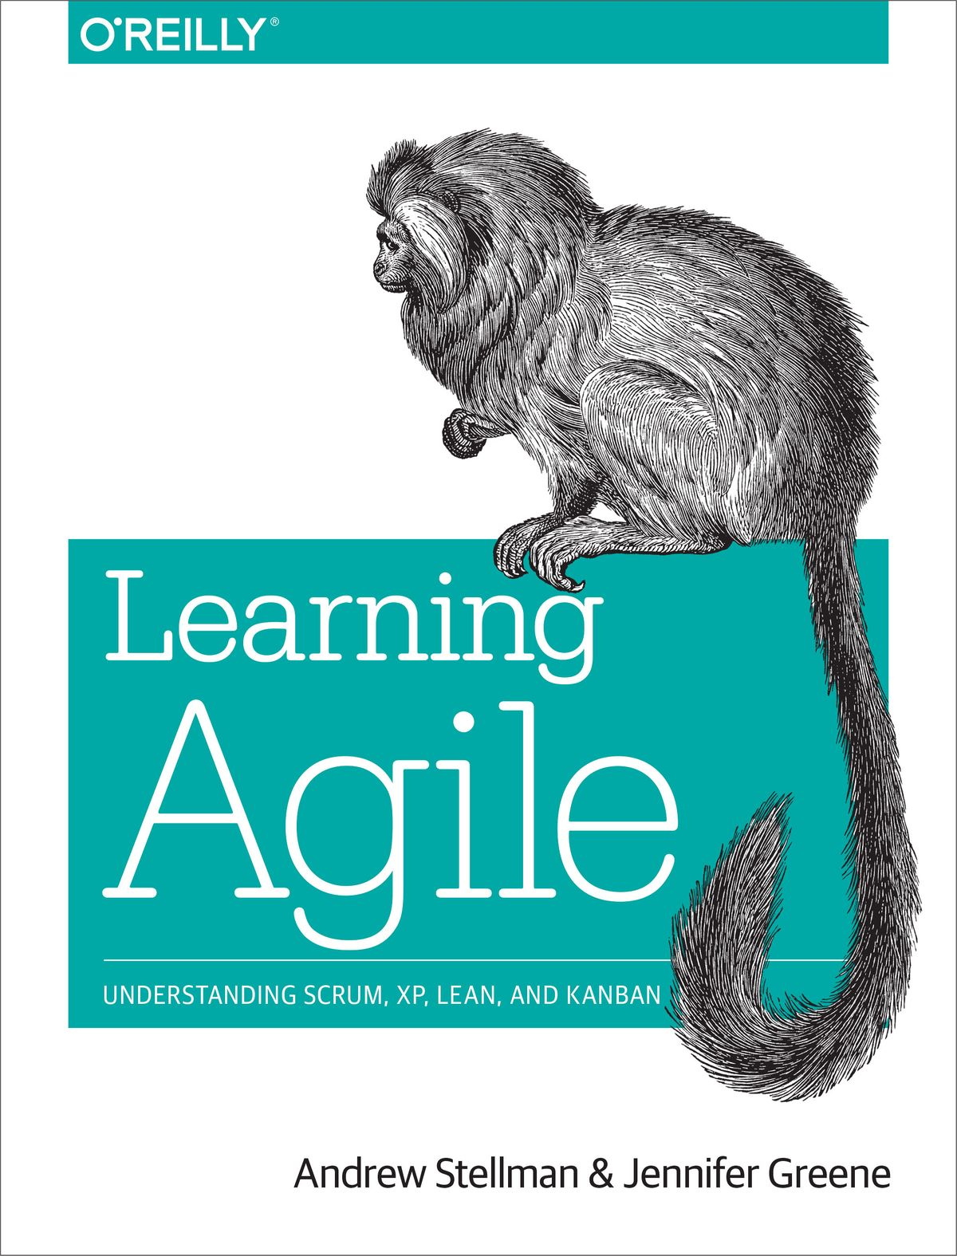

This presentation material was prepared from the following references:
Andrew Stellman and Jennifer Greene, Learning Agile, 2014, Chapter 6.
Andrew Stellman & Jennifer Greene, Head First Agile2017, Chapter 5.

